Slide 1
Can Machines Prove Geometry Like Humans?
Paper Reading Task:
“Solving Olympiad geometry without human demonstrations”
By
Mohammed Abdul Rafe Sajid

Slide 2
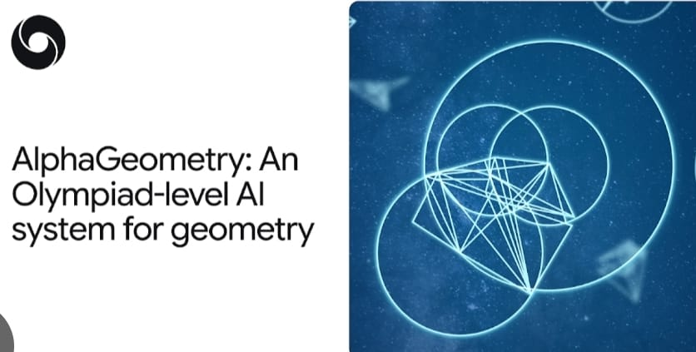
What is AlphaGeometry?
AlphaGeometry is an AI system designed to solve Olympiad-level geometry problems by constructing complete and logically verified proofs.
Unlike standard language models that generate text-based answers, AlphaGeometry produces step-by-step geometric proofs where every step is checked using formal rules.
It combines learning-based intuition with strict symbolic verification, allowing it to reason accurately over long and complex proof chains.

Slide 3
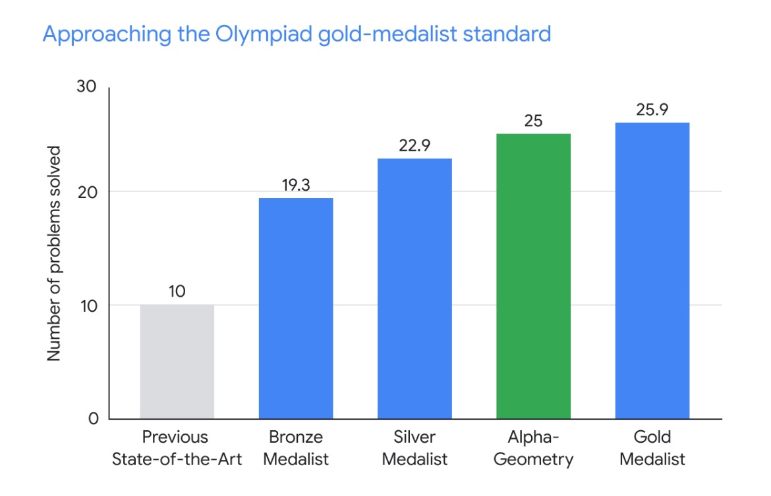
• Modern large language models like GPT-4 are extremely powerful, yet they fail to solve Olympiad-level geometry problems reliably.
• Geometry proofs require exact logical correctness, where even a single wrong step invalidates the entire solution.
• AlphaGeometry solves 25 out of 30 Olympiad geometry problems under competition time limits.
• This performance is close to that of an average human gold medalist and far beyond previous AI systems.
• This raises an important question: what makes AlphaGeometry succeed where pure language models fail?
Why is AlphaGeometry
Surprising?

Slide 4
CORE IDEA
AlphaGeometry combines:
  a neural model (to suggest ideas)
  a symbolic engine (to guarantee correctness)
It learns without human-written proofs
It is trained on 100 million synthetic geometry problems (self generated)
Symbolic Engine Consists of
1. Deductive Database (DD): responsible for deriving new geometric facts using formal rules
2. Algebraic Reasoning (AR) is responsible for checking consistency and validity of those facts using Algebraic constraints
Therefore called Neurosymbolic model

Slide 5
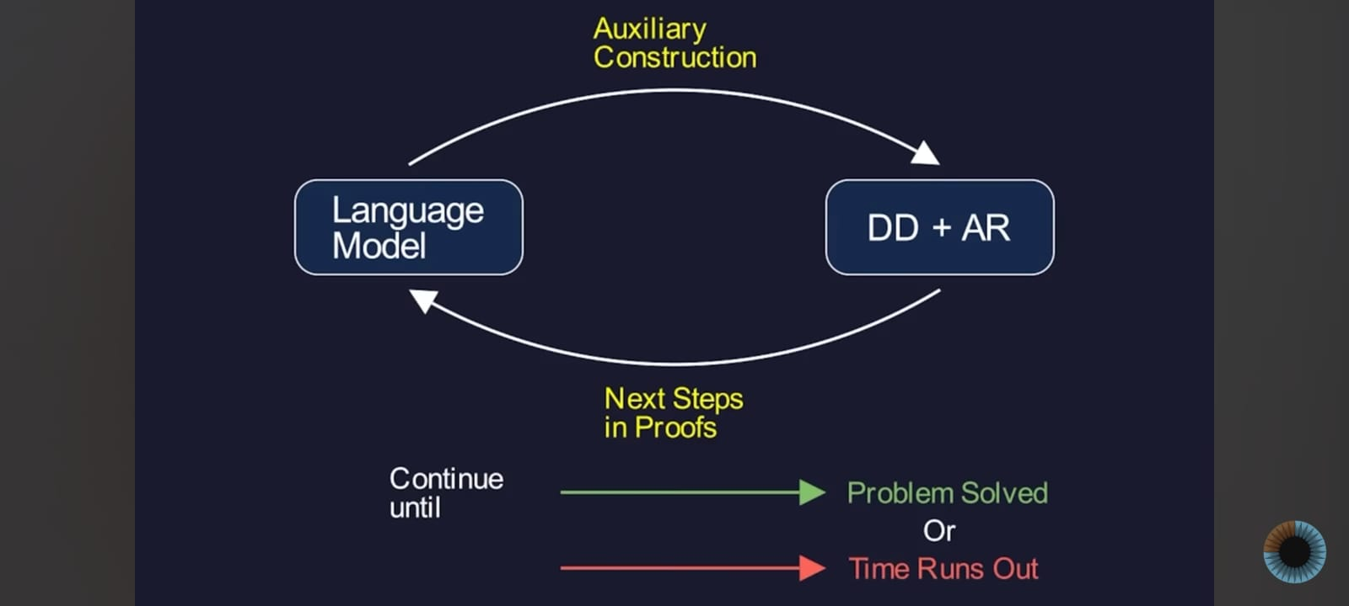

Slide 6
METHADOLOGY
How AlphaGeometry Actually Solves a Problem?
1. Symbolic engine tries to prove the theorem
2. If stuck → neural model suggests an auxiliary construction
3. Symbolic engine verifies it
4. Loop continues until solved or exhausted
Auxiliary construction = adding a helpful point/line not mentioned originally. Just like + and – sin theta in trigonometry to simplify in a form.
ANALOGY:
“Neural model is a creative student, and Symbolic model is teacher which checks the rationale and validity”

Slide 7
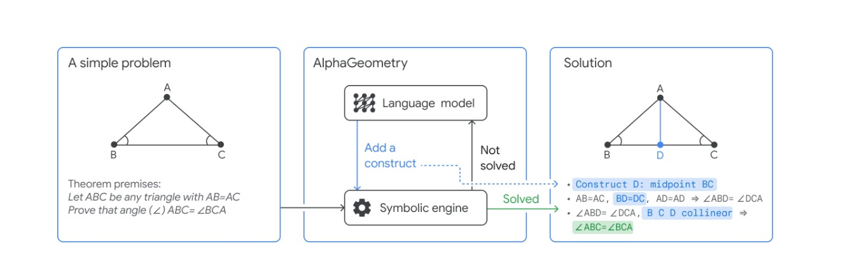

Slide 8
Why Synthetic Data Is the Real Breakthrough?
• Writing millions of correct geometry proofs by humans is practically impossible
• AlphaGeometry avoids this by generating its own geometry worlds from scratch
• It starts with valid geometric structures and derives all possible relationships
• From these proofs, it works backward to create solvable geometry problems
• This removes dependence on human demonstrations and avoids data scarcity
• Learning is flipped: instead of learning from humans, the system learns by discovering

Slide 9
Strengths
• Produces fully machine-verifiable geometry proofs
• Every reasoning step is logically checked, eliminating hallucinations
• Does not rely on any human-written proof data
• Handles long chains of reasoning that require strict correctness
• Combines creative idea generation with formal verification
• Produces proofs that are both correct and human-readable

Slide 10
Limitations
• Designed specifically for geometry and does not generalize to other areas of mathematics (domain specific)
• Requires extensive hand-engineered symbolic rules and domain knowledge
• Does not naturally extend to informal or natural-language reasoning
• Success comes from narrowing the problem domain rather than solving general reasoning
• Highlights that strong performance is still task-dependent

Slide 11
Slight Relation I observed with my project sed puzzle
• In my string-rewriting puzzle experiments, LLMs often failed due to invalid transitions
• Early mistakes in reasoning frequently made later steps impossible to recover
• Simply asking models to “reason more” was not sufficient
• Constraint-Aware State Verification (CASV) prompting looked a bit similar to AlphaGeometry’s symbolic checks
• Both approaches enforce validity at every step before moving forward
• The key lesson is that reasoning improves significantly when every action is explicitly verified

Slide 12
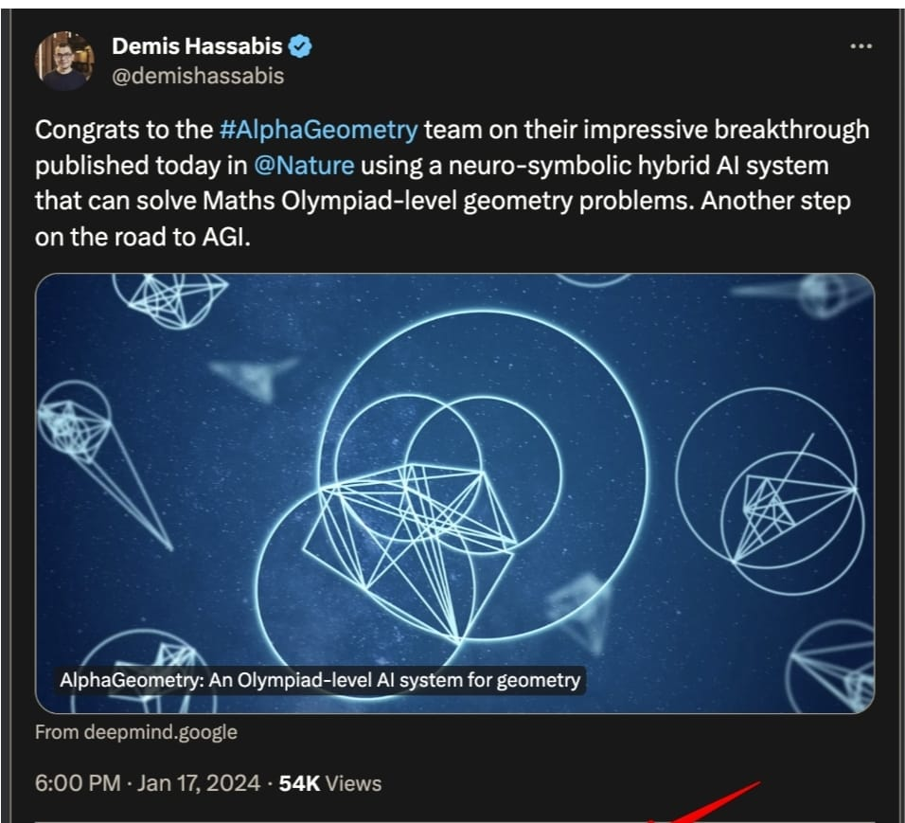
Final Takeaway
• AlphaGeometry demonstrates that strong reasoning does not come from larger models alone
• Pure pattern matching is insufficient for tasks requiring strict correctness
• Combining creative proposal with hard constraints leads to more reliable reasoning
• Verification plays a central role in preventing hallucination and invalid steps
• This work suggests a promising direction for building future reasoning systems
• True progress in AI reasoning lies in balancing intuition with constraint

